Slide 1


Budgeting and Financial Literacy

Slide 2

Empowering Mankind
MySkill - Empowering womanhood, is program with a vision to give a platform to all the women for diversifying their existing skills to meet today's challenges. MySkill aims at building actual competencies to achieve their highest desired level of independence and inclusion in their communities.
MySkill has partnered with institutes who have a proven track record of training and empowering women through various educational and experiential learning in the past.
MySkill offers a platform for all aspiring women who want to have a greater expansion in professional and personal growth which in turn contribute to structural transformation and economic growth by enhancing employability.

Slide 3
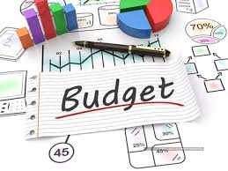
Agenda
Introduction to Budgeting Basics
Understanding Financial Literacy
Importance of Financial Literacy
Budgeting Apps Overview
Creating a Sample Budget
Tracking and Calculating Expenses
Financial Management Tools
Student Financial Literacy
Activities for Financial Literacy
Conclusion and Next Steps

Slide 4

Introduction to Budgeting Basics
Overview
Budgeting is the process of creating a plan to spend your money, ensuring that you have enough to cover your expenses while also saving for future goals. It is essential for effectively managing personal finances and achieving financial stability.
The purpose of this presentation is to familiarize teachers with digital tools and apps for budgeting and financial management. By integrating technology into financial literacy education, educators can enhance their own understanding and effectively teach these skills to their students.

Slide 5

Understanding Financial Literacy
Plus tip:
Definition
Consider adding examples of each component for better understanding, or include statistics that highlight the importance of financial literacy for different demographics.
Definition
Investing
Financial literacy refers to the ability to understand and effectively manage personal finances.
Basic knowledge of different types of investments (stocks, bonds, mutual funds) and how they work.
Budgeting
Credit Management
Understanding how to create and maintain a budget to track income and expenses.
Understanding credit scores, credit reports, and how to use credit responsibly.
Saving
Debt Management
Knowing the importance of saving money for emergencies, future goals, and investments.
Knowing how to manage and repay debts, including loans and credit cards.

Slide 6
Importance of Financial Literacy
Plus tip:
Financial Literacy
Consider adding examples of how financial literacy has impacted individuals or communities positively. You can also include statistics to support the importance of financial literacy.
Empowerment
Avoiding Debt
Financial literacy empowers individuals to take control of their financial lives. It equips them with the knowledge to make informed choices, reducing reliance on others for financial advice.
With a solid understanding of budgeting and credit, individuals are less likely to accumulate unnecessary debt and can manage existing debt more effectively.
Building Wealth
Planning for the Future
Financial literacy helps individuals understand the importance of saving and investing, enabling them to build wealth over time. Knowledge of investment options can lead to smarter financial decisions.
Financial literacy encourages proactive financial planning, including retirement savings, education funds, and emergency savings, leading to a more secure and comfortable future.

Slide 7


Budgeting Apps Overview
Plus tip:
Budgeting
Consider adding screenshots of popular budgeting apps to demonstrate their user interfaces.
User-Friendly Interfaces
Automatic Tracking
Expense Tracking Tools
Apps like Mint, YNAB (You Need A Budget), and PocketGuard allow users to create and manage budgets easily. They often come with intuitive dashboards that provide a clear overview of income, expenses, and savings.
Many apps automatically sync with bank accounts and credit cards, categorizing transactions in real time, which simplifies tracking spending habits.
Expense tracking apps like Expensify or Wally let users log expenses as they occur, providing immediate insights into spending patterns. Some tools allow users to take pictures of receipts, automatically extracting relevant information.

Slide 8
Creating a Sample Budget
Plus tip:
Budgeting
You can customize the budget examples to reflect specific scenarios relevant to your audience, such as different income levels or expense categories.
Gather Financial Information
List Income and Expenses
Calculate Total Expenses
Determine Remaining Balance
Collect financial data by listing all income sources and identifying fixed (e.g., rent) and variable expenses (e.g., groceries).
Create a detailed list of monthly income and expenses. Include total income and categorize expenses into fixed and variable.
Add fixed and variable expenses to find total monthly expenses. Use: Total Fixed + Total Variable = Total Monthly Expenses.
Calculate the remaining balance by subtracting total expenses from total income: Budget Summary = Total Income - Total Expenses.
List of income sources
List of fixed expenses
List of variable expenses
Monthly Income Summary
Monthly Fixed Expenses
Monthly Variable Expenses
Total Monthly Expenses Calculation
Remaining Balance Calculation

Slide 9
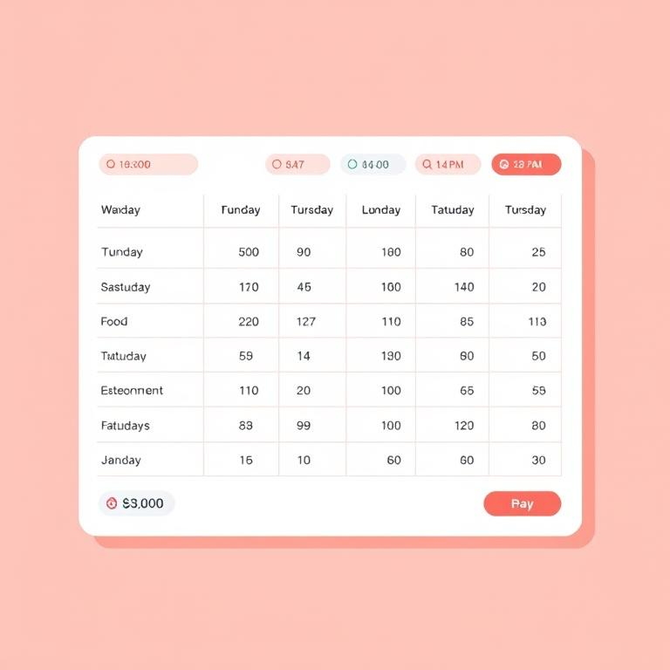
Tracking and Calculating Expenses
Plus tip:
Budgeting
Consider tailoring the expense tracking method to your lifestyle, whether using a digital app for convenience or a paper method for a hands-on approach.
Methods of Tracking Expenses
Choose a tracking method such as a paper notebook, spreadsheet, or budgeting app like Mint, YNAB, or PocketGuard.
Log expenses as they occur to maintain an accurate record. For example, if using a spreadsheet, list the date, description, category, and amount for each expense.
Calculate total expenses for the week by summing all entries to evaluate your spending habits effectively.

Slide 10
Financial Management Tools
Plus tip:
Tools
Consider adding specific examples of tools that offer these features, such as Mint for budgeting and alerts, or Expensify for expense tracking.
Alerts and Notifications
Budgeting Tools
Spending Reports
Many financial management tools offer features like spending alerts to notify users when they exceed their budget in specific categories, and bill reminders to prevent late payments and associated fees.
Customizable budgeting features allow users to create and adjust budgets for different spending categories. Some tools even provide goal setting options, enabling users to track progress towards financial goals.
Generating monthly or quarterly spending reports helps users visualize where their money goes, breaking down spending by category and aiding in better financial decision-making.

Slide 11
Student Financial Literacy
Importance
Building Essential Life Skills
Encouraging Responsibility and Independence
Preparing for Future Challenges
Fostering Long-Term Financial Health
Financial literacy equips students with the skills to make informed decisions about spending, saving, and investing, fostering critical thinking and responsible choices.
Understanding personal finance empowers students to take charge of their financial futures, promoting independence and self-reliance.
Financial literacy prepares students to navigate student loans, credit cards, and other financial responsibilities, helping them understand economic factors that affect their lives.
Early education in financial literacy encourages habits of saving and investing, laying the groundwork for a secure financial future.

Slide 12
Activities for Financial Literacy
Plus tip:
Activities
Consider customizing the activities based on students' age groups and backgrounds to ensure they connect with the financial concepts being taught.
Activity 1: Create sample budgets by gathering financial information, listing all sources of income and expenses, and calculating total monthly expenses. This hands-on approach helps students understand budgeting fundamentals.
Activity 2: Create personal budgets that reflect students' own financial situations, encouraging them to identify their fixed and variable expenses and plan accordingly.
Activity 3: Setting financial goals and tracking progress by having students outline their short-term and long-term financial objectives, such as saving for a specific item or building an emergency fund.
Activity 4: Discuss experiences using financial management tools in class, allowing students to share insights and challenges they faced while utilizing budgeting apps and tools.
Activity 5: Share their learning experiences with peers, fostering a collaborative environment where students can learn from each other's successes and strategies in managing finances.

Slide 13
Conclusion and Next Steps
Plus tip:
Conclusion
Customize this slide by adding specific digital tools or apps that you plan to use in your educational approach and any unique next steps relevant to your audience.
Utilizing digital tools for financial management is essential for enhancing budgeting skills and fostering financial literacy. These tools empower users by providing real-time tracking and insights into their financial situations, enabling informed decision-making. To effectively implement financial literacy education, educators should integrate hands-on practice with digital apps, create engaging activities for students, and provide ongoing support to build financial confidence. This approach ensures that both teachers and students are well-equipped to navigate their financial futures.

Slide 14

MySkool is an inspiration for schools, teachers, parents and students to excel in life. It is a message that ‘good is always appreciated.’ It is a push towards self motivation, an opportunity to see how others are growing and a chance to appreciate fellow human beings.

